Slide 1
Project 0: Final Presentation
Kayla Robledo
February 4th, 2026

Slide 2
Research Questions
Do caplet and booklet times agree with one another (i.e. show a one-to-one relationship)?
What does adherence look like at the 30 minute and 10 hour mark?
Do cortisol and DHEA levels increase from waking to 30 minutes after and then decrease?

Slide 3
Data Overview
372 participants → 360 participants
  Subject 3037 had 4 DHEA levels at assay upper detection limit
  2 others has DHEA levels at assay upper detection limit
  1 subject with a cortisol value above 80 nmol/L
  5 subjects with NAs for cortisol and DHEA values
Table 1. Summary Statistics of SPIT Booklet Samples
Characteristic | Waking (N = 89)¹ | 30-Minutes (N = 90)¹ | Lunch (N = 91)¹ | 10-Hours (N = 90)¹ | Overall (N = 360)¹
Cortisol (nmol/L) | 7.3 (6.0) | 9.0 (5.0) | 3.2 (2.3) | 3.2 (5.0) | 5.7 (5.4)
DHEA (nmol/L) | 1.63 (1.06) | 1.02 (0.69) | 0.51 (0.46) | 0.50 (0.65) | 0.91 (0.88)
Booklet Time (minutes)² | 1 (4) | 34 (11) | 323 (84) | 641 (85) | 242 (264)
Missing | 5 | 5 | 10 | 11 | 31
Caplet Time (minutes)² | 5 (9) | 50 (36) | 324 (79) | 659 (100) | 274 (272)
Missing | 14 | 22 | 11 | 8 | 55
¹Values are mean (SD).
²Refers to time from waking.

Slide 4
Analysis
Linear Mixed Model
  Outcome: caplet time since waking measured in minutes
  PEV: booklet time since waking measured in minutes
  Random intercept for subject
Adherence Proportions and Counts by Time:
  Time groups: 30 minutes and 10 hours
  Good adherence: deviation of 0 to ±7.5 minutes
  Adequate adherence: deviations from ±7.5 to ±15 minutes
  Poor adherence: deviations exceeding ±15 minutes
Two Piecewise Linear Mixed Model:
  Outcomes: cortisol and DHEA levels
  PEV: booklet time since waking measured in minutes
  Knot at 30 minutes
  Random intercept for subject

Slide 5
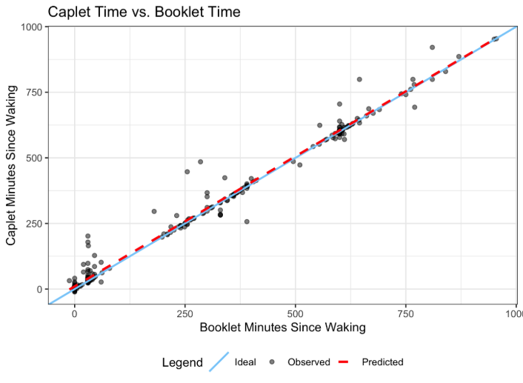
Results
Table 2. Research Question 2 Adherence Groupings
Characteristic | 30-Minutes (N = 90)¹ | 10-Hours (N = 90)¹
Adherence Group
Good | 65 (72%) | 36 (40%)
Adequate | 10 (11%) | 8 (8.9%)
Poor | 15 (17%) | 46 (51%)
¹Values are N(%).

Slide 6
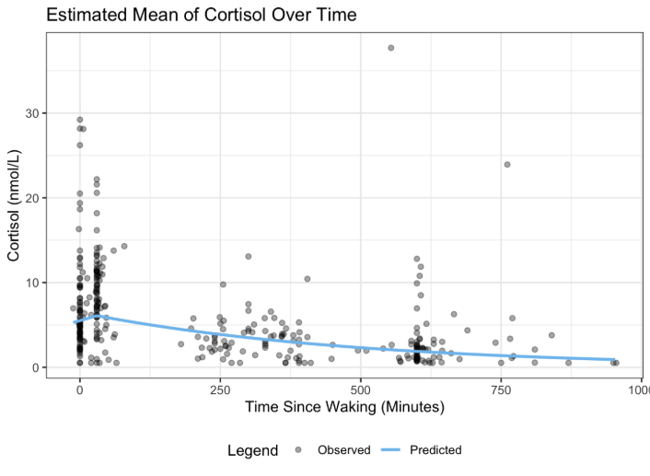
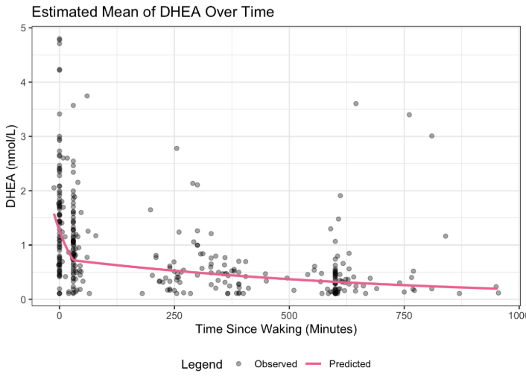
Table 3. Research Question 3 Model Statistics
Predictor | Multiplicative Effect | 95% CI | p-value
Cortisol: (Intercept) | 5.51 | (4.50, 6.73) | –
Waking to 30 Minutes | 1.0034 | (0.996, 1.011) | 0.375
Post-30-Minutes | 0.9980 | (0.9976, 0.9983) | < 0.01
DHEA: (Intercept) | 1.261 | (0.999, 1.592) | –
Waking to 30 Minutes | 0.981 | (0.975, 0.988) | < 0.01
Post-30-Minutes | 0.9986 | (0.9983, 0.9989) | < 0.01

Slide 7
Discussion
Self-reported sample times closely matched device-recorded times, supporting accuracy of the SPIT booklet
Reduced adherence later in the day
Expected diurnal cortisol pattern was observed, indicating the booklet captures physiological trends
DHEA declined across the day but did not follow the hypothesized early diurnal pattern
Missing data and measurement error required complete-case analysis and may have biased results
Model assumption violations (nonnormality, heterogeneity) may affect estimate reliability

Slide 8
Questions?

